Slide 1
Knowledge Representation
Knowledge representation (KR) is an important issue in both cognitive science and artificial intelligence.
  In cognitive science, it is concerned with the way people store and process information and
  In artificial intelligence (AI), main focus is to store knowledge so that programs can process it and achieve human intelligence.
There are different ways of representing knowledge e.g.
  predicate logic,
  semantic networks,
  extended semantic net,
  frames,
  conceptual dependency etc.
In predicate logic, knowledge is represented in the form of rules and facts as is done in Prolog.

Slide 2
Semantic Network
Formalism for representing information about objects, people, concepts and specific relationship between them.
The syntax of semantic net is simple. It is a network of labeled nodes and links.
  It’s a directed graph with nodes corresponding to concepts, facts, objects etc. and
  arcs showing relation or association between two concepts.
The commonly used links in semantic net are of the following types.
  isa → subclass of entity (e.g., child hospital is subclass of hospital)
  inst → particular instance of a class (e.g., India is an instance of country)
  prop → property link (e.g., property of dog is ‘bark)

Slide 3
Representation of Knowledge in Sem Net
“Every human, animal and bird is living thing who breathe and eat. All birds can fly. All man and woman are humans who have two legs. Cat is an animal and has a fur. All animals have skin and can move. Giraffe is an animal who is tall and has long legs. Parrot is a bird and is green in color”.

Slide 4
Representation in Predicate Logic
Every human, animal and bird is living thing who breathe and eat.
∀X [human(X) → living(X)]
∀X [animal(X) → living(X)]
∀X [bird(X) → living(X)]
All birds are animal and can fly.
∀X [bird(X) ∧ canfly(X)]
Every man and woman are humans who have two legs.
∀X [man(X) ∧ haslegs(X)]
∀X [woman(X) ∧ haslegs(X)]
∀X [human(X) ∧ has(X, legs)]
Cat is an animal and has a fur.
animal(cat) ∧ has(cat, fur)
All animals have skin and can move.
∀X [animal(X) → has(X, skin) ∧ canmove(X)]
Giraffe is an animal who is tall and has long legs.
animal(giraffe) ∧ has(giraffe, long_legs) ∧ is(giraffe, tall)
Parrot is a bird and is green in color.
bird(parrot) ∧ has(parrot, green_colour)

Slide 5
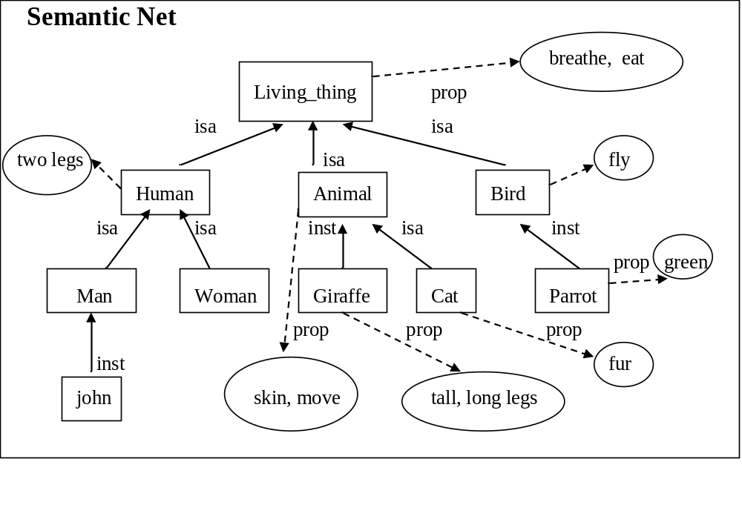
Representation in Semantic Net

Slide 6
Inheritance
Inheritance mechanism allows knowledge to be stored at the highest possible level of abstraction which reduces the size of knowledge base.
  It facilitates inferencing of information associated with semantic nets.
  It is a natural tool for representing taxonomically structured information and ensures that all the members and sub-concepts of a concept share common properties.
  It also helps us to maintain the consistency of the knowledge base by adding new concepts and members of existing ones.
Properties attached to a particular object (class) are to be inherited by all subclasses and members of that class.

Slide 7
Extended Semantic Network
In conventional Sem Net, clausal form of logic can not be expressed.
Extended Semantic Network (ESNet) combines the advantages of both logic and semantic network.
In the ESNet, terms are represented by nodes similar to Sem Net.
Binary predicate symbols in clausal logic are represented by labels on arcs of ESNet.
  An atom of the form “Love(john, mary)” is an arc labeled as ‘Love’ with its two end nodes representing ‘john’ and ‘mary’.
Conclusions and conditions in clausal form are represented by different kinds of arcs.
  Conditions are drawn with two lines and conclusions are drawn with one heavy line .

Slide 8
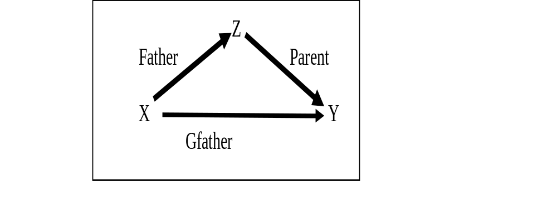
Examples
Represent ‘grandfather’ definition
Gfather(X, Y) ← Father(X, Z), Parent(Z, Y) in ESNet.

Slide 9
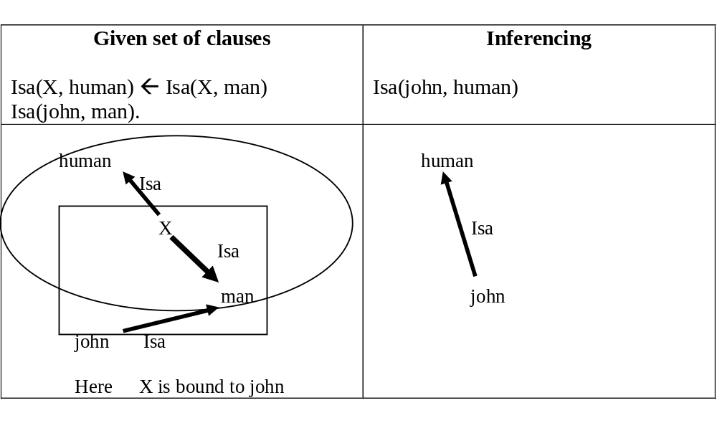
Example: Bottom Up Inferencing

Slide 10
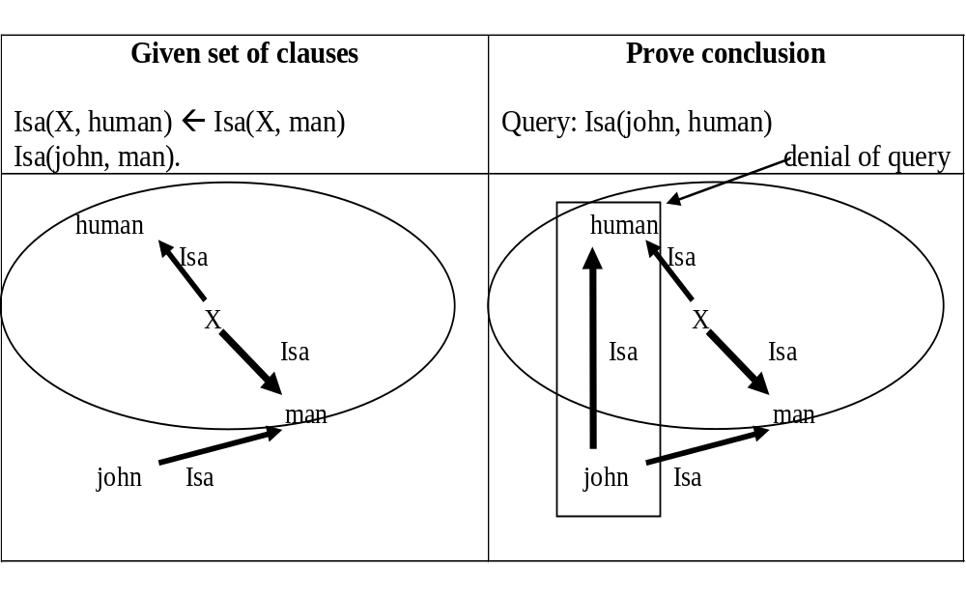
Example: Top Down Inferencing

Slide 11
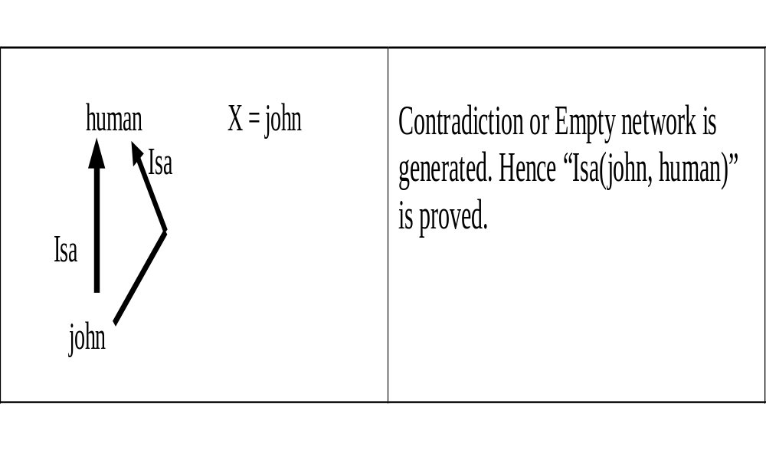
Cont…

Slide 12
Unification
UNIFY(Knows(John,x),Knows(John,Jane))
UNIFY(Knows(John,x),Knows(y,Bill))
UNIFY(Knows(John,x),Knows(y,Mother(y)))
UNIFY(Knows(John,x),Knows(x,Elizabeth)) -FAIL

Slide 13
